Slide 1
YMCA PENSION PLAN
2020 Triennial Actuarial Valuation

Slide 2
Introduction and Roles
Principal Employer – England & Wales – Jamie Hutchinson
Pension Plan Trustee – Chair – Alan Botterill
Pension Liability Reduction Group – Ian Dow

Slide 3
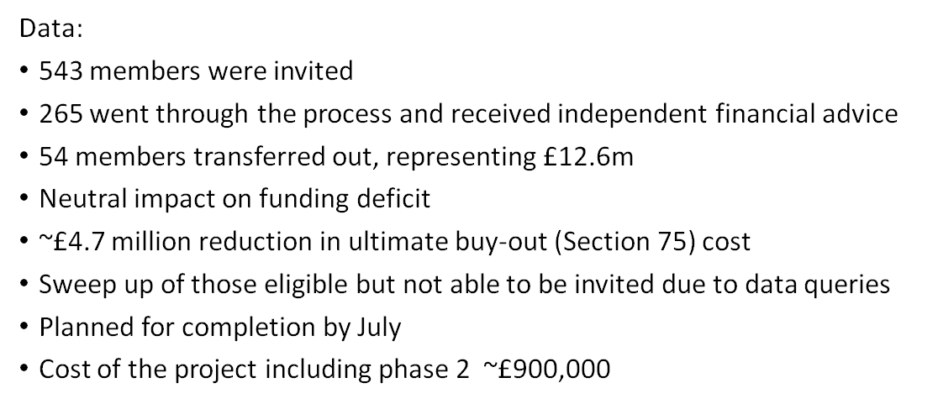
Enhanced Transfer Value (ETV) exercise outcomes

Slide 4
Pension Plan Background
Multi-employer plan – over 70 - “last man standing”
Closed to new entrants – 1 May 2007
Closed to accrual of benefits – 1 May 2007
Broke pension link with final salary – 1 May 2011
Accrued benefits for non-retired are revalued each year
Many members have service with more than one YMCA
Membership at 1 May: 2020 2017 2014
Non-retired – 741 919 1,046
Pensioners – 598 609 554
Assets - ~£150 million
Managed by appointed investment manager
Overseen by Investment sub-committee

Slide 5
2020 Triennial Actuarial Valuation - Background
Formal valuation required every 3 years on 1st May
Assumptions, level and duration of contributions must be agreed with The Pensions Regulator – strength of employer covenant is a key consideration
Trustee responsibility but need to consult with the Employer
YMCA approach is collaborative with a joint Triennial Valuation Sub-committee (4 Trustees, 4 Employer + Jamie Hutchison, both capacities)
Works with Plan Actuary to review actuarial assumptions and results, including affordability of contributions, and agree ultimate outcomes to present to The Pensions Regulator
An independent review of assumptions
An independent employer covenant review was undertaken by KPMG

Slide 6
Employer Covenant Assessment
Assessment = Tending to Weak
Legal obligations TTS Trustee power to set contributions
Funding need TTW ~80% funded, need for growth assets
Current financial res. TTS aggregate net assets > S75 debt
Pros Financial perf. TTW ability to pay, difficult trading
Medium/long term TTS diversity +ve, social housing solid
Employer insolvency TTS power to section, Last Man Standing
Trustee has set up committee to monitor covenant and to provide guidance in relation to pension obligations where a YMCA is in financial difficulties

Slide 7
2020 Triennial Actuarial Valuation – Results
Key points:
Initial results showed deficit of £45.0 million with current DRCs payable until 2031, an extra 4 years
Covid19 had impacted investment markets at 1 May - reduced long-term interest rates (increasing the value of liabilities) and depressed asset values
Mortality and other demographic assumptions – after independent review, removing some higher levels of caution, reduced the deficit by £6.1 million to £38.9 million based on 1 May 2020 investment conditions
Allowing for improvement in investment markets to end November reduced the deficit by £3.1 million
The final deficit was £35.8 million with current DRCs payable until 2029, an extra 2 years

Slide 8
2020 Triennial Actuarial Valuation - Results
1 May 2020 1 May 2017
Liabilities (technical provisions) £185.0 m £174.8 m
Assets £146.1 m £141.2 m
Deficit – 1 May 2020 £ 38.9 m £ 33.6 m
Deficit – 30 November 2020 £ 35.8 m
Deficit Reduction Contributions** no change no change
DRCs payable for: 9 years from 2020 10 years from 2017
increase in expected period 2 years 0 years
Section 75 Deficit £90.2 m £103.5 m
(** - DRCs increase by 3% each year)

Slide 9
Deficit Reduction Contributions (DRCs)
The Deficit Reduction Contributions represent the total sum to be paid to the Plan by all the employers to eliminate the deficit within a defined period
As the deficit has increased, there is a need to increase the total amount paid
At this difficult time for all employers, rather than increase the annual amount payable, the period has been extended by 2 years to 9 years from 2020 – this has been put to The Pensions Regulator for approval
Investment markets are unpredictable - the challenging conditions of 2020 with Covid19 plus the uncertainty caused by Brexit have impacted economic and investment conditions

Slide 10
Deficit Reduction Contributions (DRCs)
The YMCA intends that the Plan should operate on a collective basis with each employer paying their fair share of the overall deficit
The shares of the deficit change over time as the membership attributable to each employer changes with increasing age, deaths, transfers-out etc.
The current split among employers was agreed in 2014 and remained unchanged in 2017. We have chosen not to change the split this year, and to leave it unchanged for 1 year.
During the course of the next few months we will complete the ETV exercise and perform a re-evaluation of its impact.
We will consult and communicate the proposed changes in the split before the end of November

Slide 11
Communications
Your Section75 liability will be provided to you in the first week of February
There are now constant changes to the Pension position, due to legislation, market conditions, mergers, (sadly) failures, even Covid.
We would like to provide more frequent information to all employers from the Pension Trustee and the Principal Employer.
We plan to provide an update to all employers twice per year which will give information on
The changes in the overall position, legal changes, etc
An update on the liability position, investment performance, etc (indicative)
Detailed figures for the S75 liabilities of the individual employer (annual)

Slide 12
Summary
The total DRCs will not change from the current approach (subject to The Pensions Regulator’s approval - expected; next formal assessment of the total will be at the next actuarial valuation at 1 May 2023)
These are expected to be payable until 2029, an extension of 2 years
Your own share of the total DRCs will not change for the year commencing 1 May 2021
You will need to recognise the longer expected payment period in your accounts
We will review the allocation of the total DRCs among employers later this year after the ETV exercise is completed
We will continue to consider other liability management options beyond the conclusion of the ETV

Slide 13
Questions Please put any immediate question in the chat
Email
Jamie Hutchinson – Director of Resources, E&W JamieHutchinson@pensionsymca.org.uk
Gwynne Jarvis – Pension Plan Company Secretary
gwynnejarvis@pensionsymca.org.uk

